Slide 1
MAZE SOLVER
A Path Finding Algorithm Project

Slide 2
What is a Maze?
A maze is a complex network of interconnected paths or passages, often with dead ends and only one or a few correct paths leading from a starting point to a goal.
Why Solve It?
Real-world applications: Maze-solving is foundational in robot navigation, AI pathfinding, and game design.
Algorithm practice: It helps in understanding core data structures and algorithms like DFS, BFS, and A*.
Decision-making training: Simulates how intelligent agents can make optimal choices in uncertain environments.

Slide 3
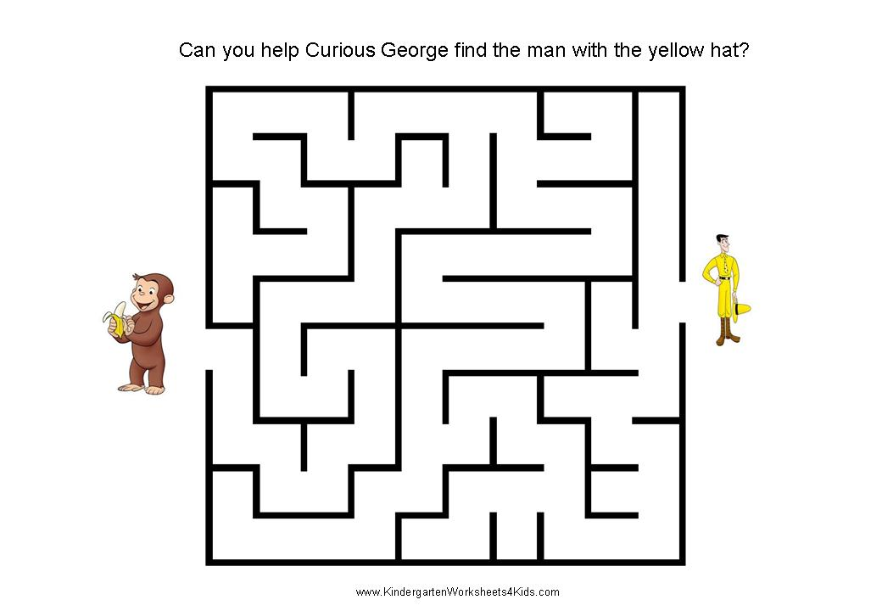
Objective of the Project
To implement an efficient algorithm to solve any given maze.
To visualize the pathfinding process using programming (e.g., Python, C++).
To compare algorithms like DFS, BFS, and A* in terms of speed and accuracy.
To understand how such solutions apply to real-world scenarios like robot navigation and game AI.

Slide 4
Applications of Maze Solving
Robotics
Autonomous robots use maze-solving algorithms to navigate unknown environments.
Helps in obstacle avoidance and path planning in indoor or outdoor spaces.
Example: A robot moving from point A to point B in a warehouse.
2. Game Development
Many games (like puzzles or dungeon crawlers) use maze logic for level design and enemy AI.
Example: Pac-Man ghosts use pathfinding algorithms.
3. Navigation Systems
Used in GPS applications to find the best route between two locations.
Helps in traffic optimization, shortest path calculation, and real-time rerouting.
Example: Google Maps using A* or Dijkstra’s algorithm under the hood.

Slide 5
Algorithms Used in Maze Solving
Depth First Search (DFS)
Explores as far as possible along one branch before backtracking.
2. Breadth First Search (BFS)
Explores all neighboring nodes level by level.
Uses a queue.
Always finds the shortest path in unweighted graphs.
3. A* (A-Star) Algorithm
Combines features of DFS and BFS using a heuristic (like Manhattan distance).
Requires cost functions: f(n) = g(n) + h(n)

Slide 6
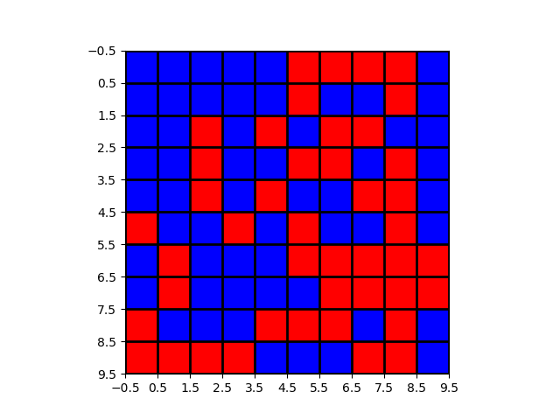
Maze Representation
Grid-Based Structure
The maze is typically represented as a 2D grid or matrix.
Each cell in the grid can be:
A path (open for movement)
A wall (blocked or obstacle)
Cells have coordinates like (x, y) used for algorithm traversal.
Helps in applying algorithms like BFS, DFS, and A* easily.

Slide 7
Input & Output
User Input
Start Point (S) and End Point (E) must be defined by the user or pre-configured.
Maze can be:
Hardcoded as a matrix/grid.
Uploaded from a file (like a text file or image).
Final Output
The algorithm processes the maze and displays the shortest/valid path from S to E
.
The output shows:
Visited nodes
Final path traced

Slide 8
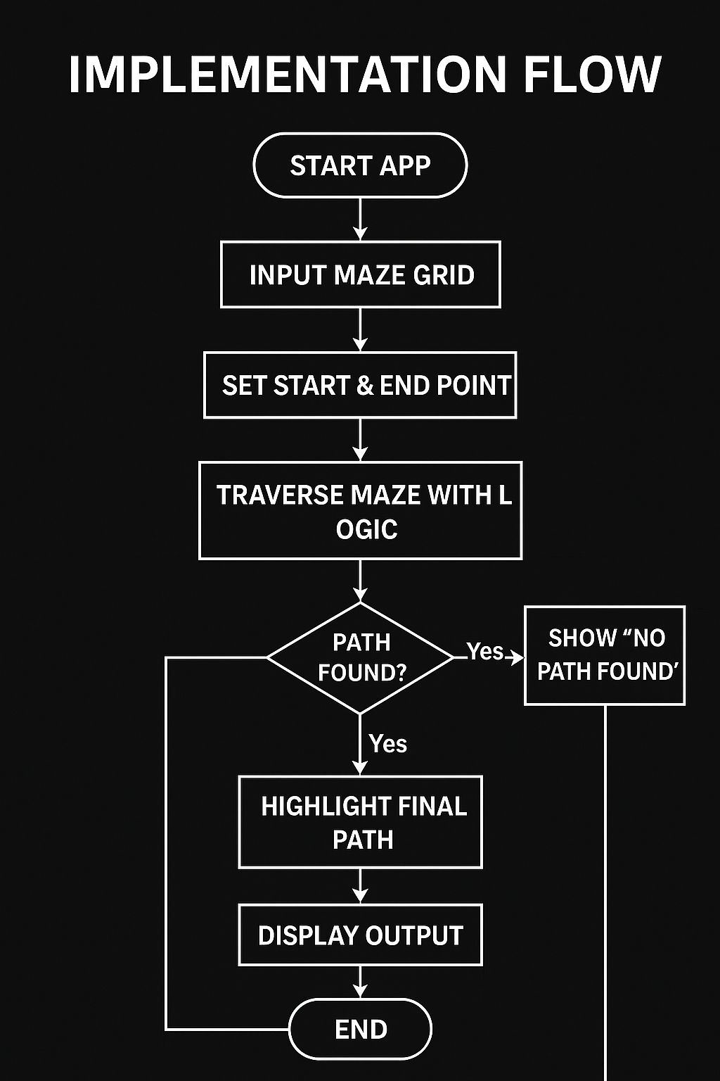
Implementation Flow
Step-by-Step Logic:
Input the Maze Grid
Represent maze as a 2D array (0 = path, 1 = wall).
Take Start and End Points
User provides coordinates of Start (S) and End (E).
Select Algorithm
Choose from DFS, BFS, or A* for solving.
Apply Algorithm
Traverse through the maze using logic:
Trace Path
On reaching the end, backtrack to form the shortest/valid path.
Display Output
Highlight final path on grid.

Slide 9
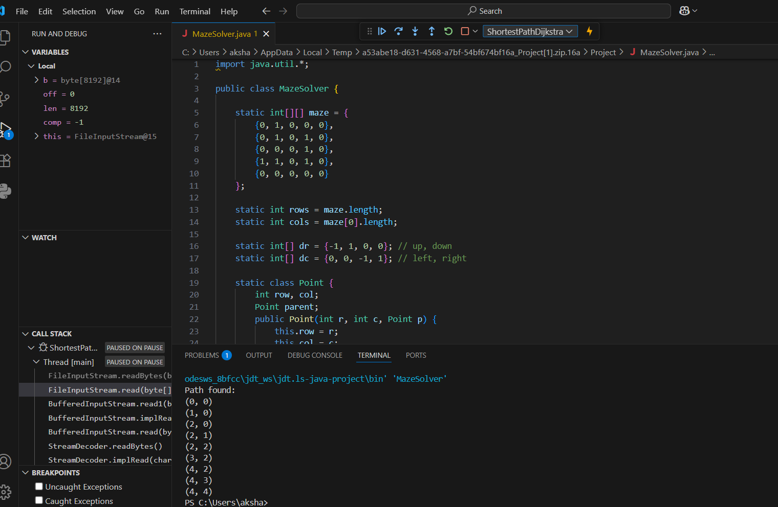
Sample Code Snippet

Slide 10
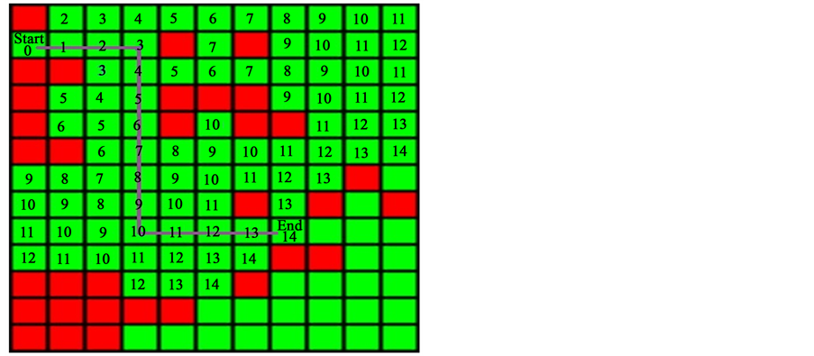
Demo & Result

Slide 11
Challenges Faced During the Project
1. Maze Complexity
Designing larger or more complex mazes increased processing time.
2. Algorithm Efficiency
DFS gave solutions but not always shortest paths.
A* needed proper heuristic tuning to be optimal.
3. Grid Representation
Mapping between 2D grid cells and algorithm logic took time.
4. Visualization
Building clear and interactive output to show visited nodes and paths.
5. Testing Edge Cases
Mazes with no path or multiple paths needed special handling.

Slide 12
Future Scope of Maze Solver Project
1. Real-Time Robot Navigation
Integrate with sensors and hardware to guide autonomous robots in real environments.
2. Game Development & AI Bots
Enhance maze-solving logic for AI agents in games.
3. GPS & Smart Navigation
Implement more advanced algorithms (like Dijkstra + A* hybrid) for real-world pathfinding in maps or GPS systems.
4. Machine Learning Integration
Train ML models to predict best paths or adapt solving strategies in changing environments.
5. 3D Maze Solving
Extend from 2D to 3D environments, useful in VR, simulation games, and drone navigation.

Slide 13
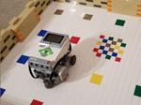
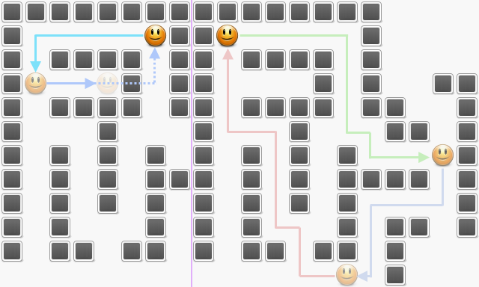
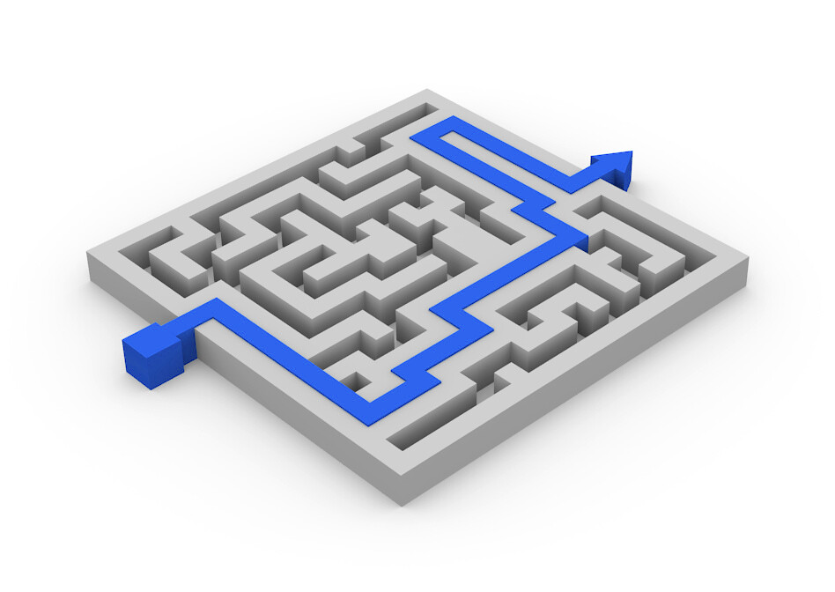

Slide 14
Conclusion
Summary
Successfully developed a maze-solving application using algorithms like DFS, BFS, and A*.
Implemented efficient logic to find and visualize the shortest path from start to end.
Understood real-world use cases and challenges in pathfinding and navigation systems.
Key Learnings
Gained hands-on experience with graph traversal algorithms.
Improved problem-solving and logical thinking skills.
Learned the importance of algorithm selection based on maze size, structure, and requirements.

Slide 15


